Slide 1
AQA
A Level
Computer Science
Paper 1
Searching and sorting
Unit 8
Algorithms

Slide 2
Objectives
Know and be able to trace and analyse the time complexity of the linear search and binary search algorithms
Be able to trace and analyse the time complexity of the binary tree search algorithm
Know and be able to explain and trace and analyse the time complexity of the bubble sort algorithm
Be able to trace and analyse the time complexity of the merge sort algorithm

Slide 3
Searching algorithms
Searching for a particular item in a list or a database is a very common operation in computing
The cards list the top ten most popular girls’ names in England in 2015, and the number of babies given each name
Amelia 5,327 | Olivia 4,724 | Isla 4,012 | Emily 3,991 | Poppy 3,273
Ava 3,171 | Isabella 3,022 | Jessica 2,995 | Lily 2,965 | Sophie 2,905

Slide 4

Searching algorithms
Using the cards, you can try out two searching algorithms
Start by putting the cards face down in a line in random order
How many babies were named Lily in 2015?

Slide 5
Linear search
The only systematic way of finding out is to look at each card, starting with the first card, until you find Lily
How many cards did you have to turn up?
If there are n names in a list, what is the average number of names that will have to be examined?
What is the “worst case scenario”?

Slide 6
Algorithm for linear search
Complete this algorithm:
SUB linearSearch(namelist,nameSought)
index ← -1
i ← 0
found ← False
WHILE i < length(namelist) AND NOT found
IF namelist[i] = nameSought THEN
??????
??????
ENDIF
??????
ENDWHILE
RETURN index
ENDSUB

Slide 7
Analysing the algorithm
How many steps are there in the algorithm? What is its time complexity?
SUB linearSearch(namelist,nameSought)
index ← -1
i ← 0
found ← False
WHILE i < length(namelist) AND NOT found
IF namelist[i] = nameSought THEN
index ← i
found ← True
ENDIF
i ← i + 1
ENDWHILE
RETURN index
ENDSUB

Slide 8
Big-O for linear search
There are 2 statements in the loop (an IF statement and an assignment statement) and 3 at the start
SUB linearSearch(namelist,nameSought)
index ← -1
i ← 0
found ← False
WHILE i < length(namelist) AND NOT found
IF namelist[i] = nameSought THEN
index ← i
found ← True
ENDIF
i ← i + 1
ENDWHILE
RETURN index
ENDSUB
Total number of steps = 2n + 3 in worst case
Time complexity = O(n)

Slide 9
Bubble sort
You can sort the name cards manually using a bubble sort, which you have probably already met
n = len(names)
FOR i = 0 to n - 2
FOR j = 0 to(n – i - 2)
IF names[j] > names[j + 1]
Swap the names
ENDIF
ENDFOR
ENDFOR
A binary search is much more efficient, but the items in the list must be sorted

Slide 10
Analysing the bubble sort
How many statements are there in the worst case scenario, in which a swap is made every time?
Assume that “swap the items” counts as three statements
FOR i = 0 to n - 2
FOR j = 0 to(n – i - 2)
IF names[j] > names[j + 1]
Swap the names
ENDIF
ENDFOR
ENDFOR

Slide 11
Big-O for bubble sort
The statements in the inner nested loop are performed n(n-1 + n-2 + n-3 +….. 1)
This is approximately an² +bn statements
Ignoring the coefficient of n² and the term in n, the time complexity = O(n²)
FOR i = 0 to n - 2
FOR j = 0 to(n – i - 2)
IF names[j] > names[j + 1]
Swap the names
ENDIF
ENDFOR
ENDFOR

Slide 12
Binary search
The binary search is a very efficient way of searching a sorted list
Examine the middle item in the list
If this is the one you are searching for, return the index
Eliminate half the list, depending on whether the item being sought is greater than or less than the middle item
Repeat until the item is found or is proved to be not in the list

Slide 13
Worksheet 3
Try the activities and questions in Task 1

Slide 14
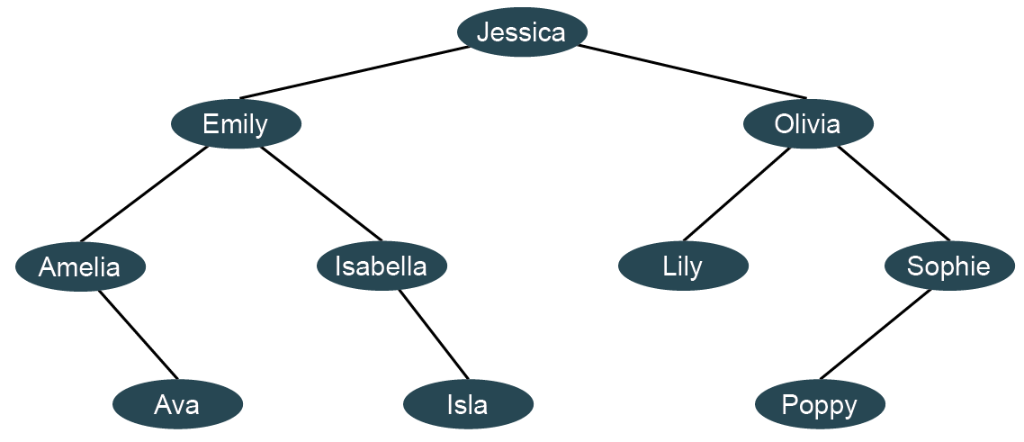
Binary tree search
The names have been put into a binary search tree
What is the maximum number of searches to find any name?
What is the order of complexity?

Slide 15
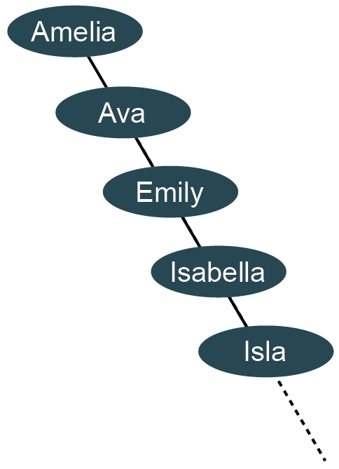
A balanced binary tree
Note that the tree on the previous slide is balanced, as each side has three levels below the root
An unbalanced tree would look like the one on the right
What effect would this have on the search time?
What would be the Big-O time complexity?

Slide 16
The merge sort
This is much more efficient than the bubble sort
The basic steps are:
Divide the unsorted list into n sublists, each containing one element
Repeatedly merge two sublists at a time to produce new sorted sublists until there is only one sublist remaining. This is the sorted list.
We will use a list of 8 integers to demonstrate the process

Slide 17
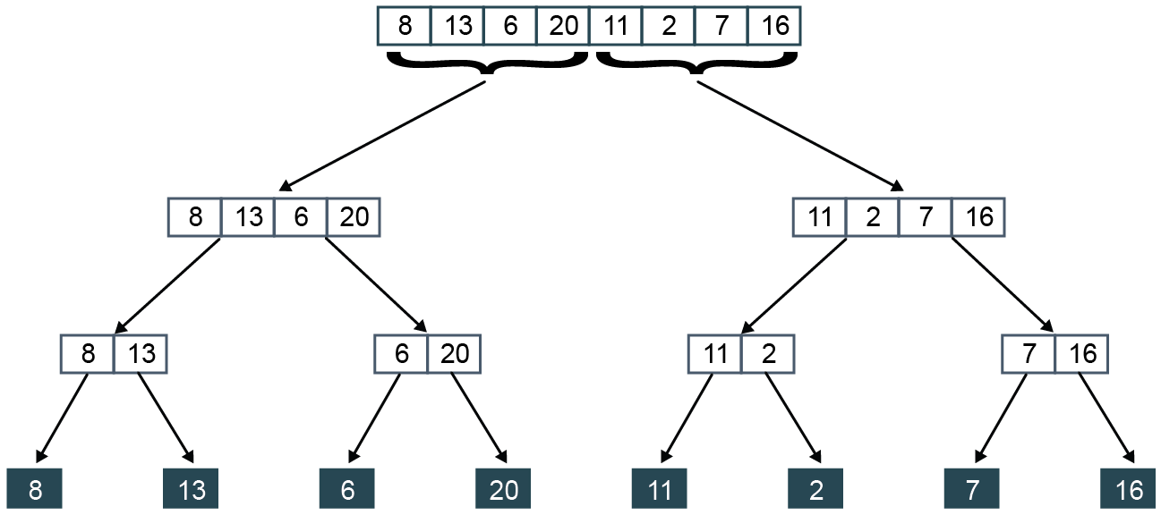
Merge sort part 1
Divide the unsorted list into n sublists

Slide 18
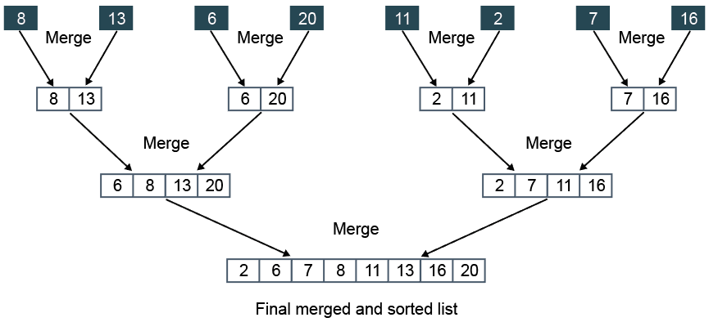
Merge sort part 2
Now merge the pairs of sublists into a single sorted list

Slide 19

Merging two lists
List A List B
Read item from list A; Read item from list B.
Write smaller to output list.
Read next item from the list that held the smaller value
Repeat until all items written to output list

Slide 20
Worksheet 3
Try manually merging the unsorted list of names
Complete Task 2
Amelia 5,327 | Olivia 4,724 | Isla 4,012 | Emily 3,991 | Poppy 3,273
Ava 3,171 | Isabella 3,022 | Jessica 2,995 | Lily 2,965 | Sophie 2,905

Slide 21
Big-O for the merge sort
This is another example of a ‘divide and conquer’ algorithm which halves the size of each list to be merged
First the list is split into halves, log₂n times
Each of these log₂n splits requires n operations to merge the data into a single list
So, the time complexity is O(n log₂n)

Slide 22
Plenary
The binary search is a very efficient algorithm for searching a sorted list
You should be able to trace its execution
There are many different sorting algorithms, with different time complexities
You need to be able to trace the algorithms for a simple sort
You should be able to describe the general principle of the merge sort

